Slide 1

Accuracy Metrics
-- Mounika Voriganti

Slide 2
Confusion Matrix
The technique for summarizing the performance of a classification algorithm.
This is also known as an “Error matrix”.
Confusion matrix is used to compare predicted and actual values.
Why you need Confusion matrix ?
It is extremely useful for measuring Recall, Precision, Specificity, Accuracy.

Slide 3
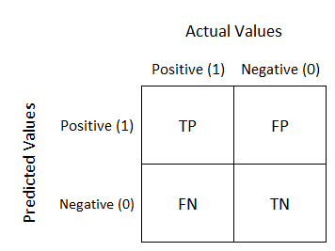
Confusion Matrix Image
A good model is one which has high TP and TN rates, while low FP and FN rates.

Slide 4
True Positive: Actual Positive and Predicted as Positive
True Negative: Actual Negative and Predicted as Negative
False Positive(Type I Error): Actual Negative but predicted as Positive
False Negative(Type II Error): Actual Positive but predicted as Negative

Slide 5

Precision
Precision should be high as possible.
Precision tells us how many of the correctly predicted cases actually turned out to be positive.
Recall
Recall tells us how many of the actual positive cases we were able to predict correctly with our model.
TP/Actual Yes

Slide 6

ACCURACY
(TP+TN )/ Total
i.e
F1-Score:
F1-score is a harmonic mean of Precision and Recall.
so it gives a combined idea about these two metrics. It is maximum when Precision is equal to Recall.
It is difficult to compare two models with low precision and high recall or vice versa. So to make them comparable, we use F-Score.
(2*Precision*Recall)/Precision*Recall

Slide 7
Thank You

